Slide 1

VECTO 2.2 22.07.2015
Release Notes

Slide 2
VECTO 2.2
Main updates
Moved gear-specific Full Load Curves to Gearbox File
Combined Drag Coefficient * Cross Sectional Area in one input parameter
Removed WHTC Correction Factor Calculation.
Added link to CITnet / JIRA

Slide 3
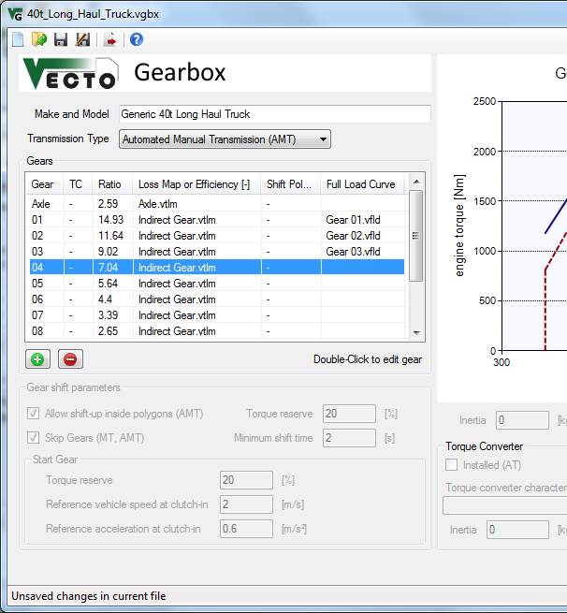
Gear-specific Full Load Curves
Gear-specific Full Load Curves are now defined in the Gearbox File
Used for torque limiting
Basis for generic shift polygons*
If no file is defined, the engine full load curve is used.
* If the engine full load torque is lower than the gear full load, then the engine full load is used to prevent unreasonable shifting with small engines.

Slide 4
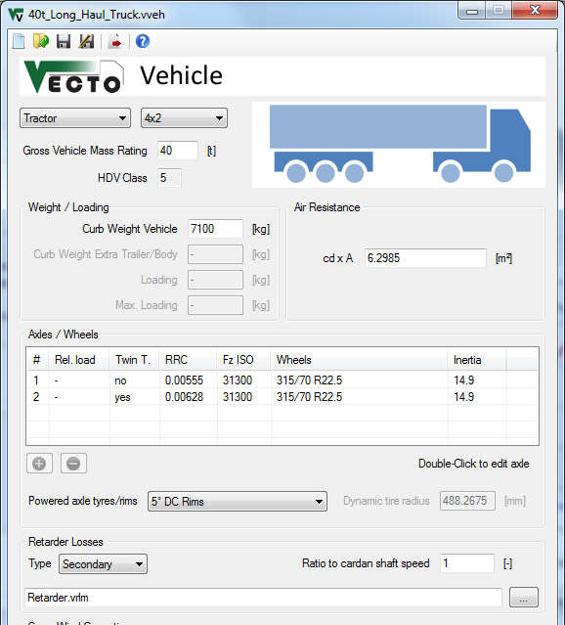
Combined Drag Coefficient * Cross Sectional Area
VECTO now uses the c_{d}xA product instead of separating the two parameters
VECTO CSE exports the c_{d}xA product, which can now be inserted without separating.
Old .vveh files are compatible.

Slide 5
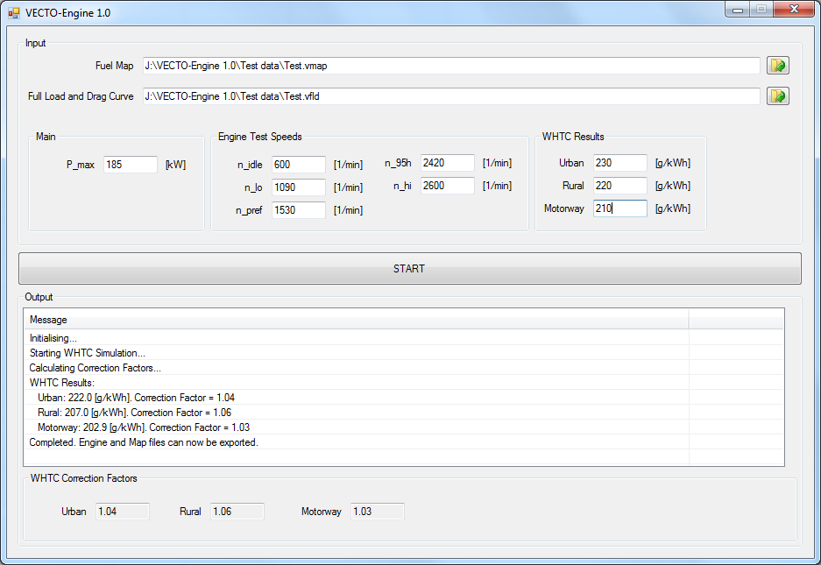
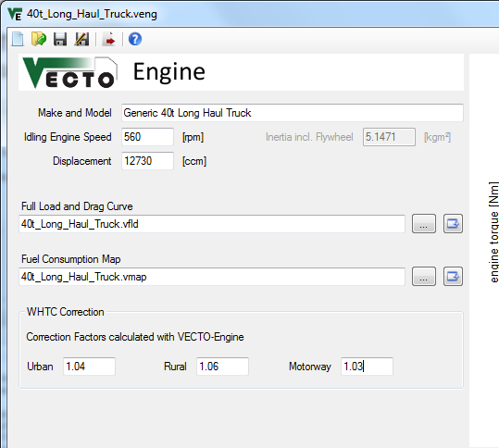
Removed WHTC Correction Factor Calculation
The WHTC Correction Factors are now calculated in an external tool, VECTO-Engine and have to be entered in the VECTO Engine file (.veng)
VECTO-Engine
Engine Editor

Slide 6
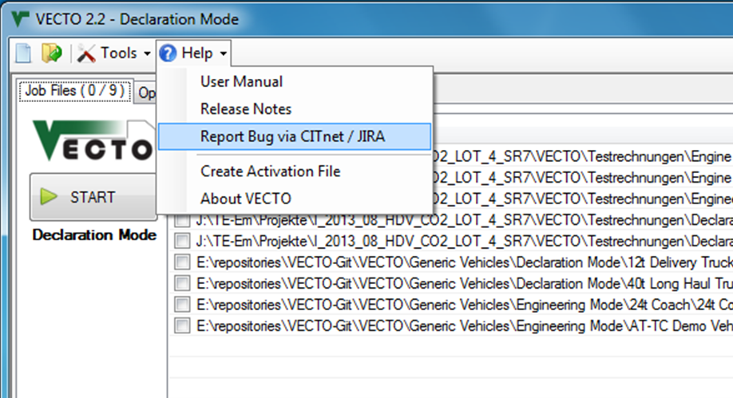
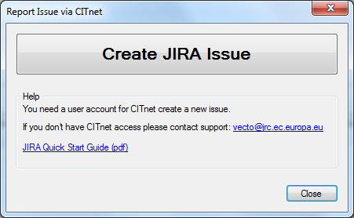
Create JIRA Issue
Use the button in the Help menu to go to JIRA or open a Quick Start Guide.

Slide 8
VECTO 2.1 21.04.2015
Release Notes

Slide 9
VECTO 2.1
New AT/TC options:
Limit engine rpm in torque converter operation acc. ≥ acc_{min}
Shift up (C-to-L, L-to-L) if acc. ≥ acc_{min} and next-gear-rpm > threshold
rpm limit [1/min] and acc_{min} [m/s²] parameters are currently user-defined
C-to-C up-shift condition based on N80h engine speed (instead of N95h)
P_{wheel} input (SiCo test mode)
P_{wheel} as cycle input
Overwrites power calculation
VECTO only calculates power train losses, engine torque/rpm and fuel consumption

Slide 10
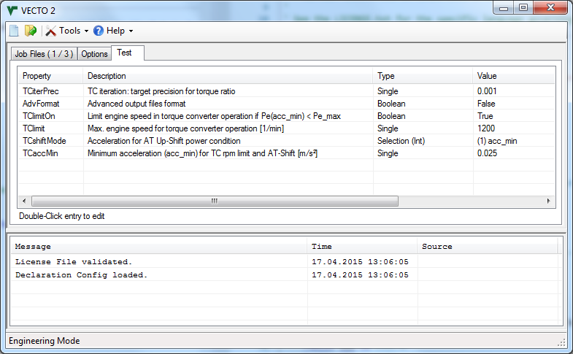
AT/TC model update
"Test" tab in main form includes new parameters.
Note: This is a temporary solution until model and parameters are verified!

Slide 11
AT/TC model update
New AT/TC paramters:
TClimitOn (True / False)
Enables engine rpm limit in TC operation
TClimit [1/min]
engine rpm limit (if TClimitOn = True)
TCshiftMode (0/1)
Mode 0: acc_target - Shift up if power demand with target acc. < power-max (pre-V2.1 default)
Mode 1: acc_min - Shift up if power demand with min. acc. < power-max
TCaccMin [m/s²]
Minimum acceleration for ShiftMode 1 and TClimit
Note: This is a temporary solution until model and parameters are verified!

Slide 12
AT/TC model update
Change parameters in Test tab by double-click
Parameters are saved on application level (..\config\DEVconfig.txt)
Note: This is a temporary solution until model and parameters are verified!

Slide 13
P_{wheel} Input (SiCo Mode)
P_{wheel} can be defined in driving cycle to overwrite power calculation
Requires Gear and Engine Speed input
Cycle identifier: <Pwheel>
Only time-based cycles are supported
Distance Correction must be disabled (Options tab in main form)
Example driving cycle

Slide 14
P_{wheel} Input (SiCo Mode)
Constant point calculation
Define (at least) two identical times steps
(Optional) Add additional auxiliary power consumption with <Padd>
It is suggested to define one cycle per constant point and use Batch Mode
Example: Calculation of two constant points tests
Cycle 1.vdri
.vsum results
Cycle 2.vdri

Slide 15
Full Changelog V2.1
Limit engine rpm in torque converter operation acc. > acc_min
Shift up (C-to-L, L-to-L) if acc. > acc_min and next-gear-rpm > threshold
C-to-C up-shift condition based on N80h engine speed (instead of N95h)
Pwheel-Input (SiCo Mode)
FC [g/h] is always saved in output (in addition to [g/km]), not only in Engine Only mode
GUI: Corrected air density unit in GUI
Bugfix: Format error in .vmod header
VECTO 2.0.4-beta4_Test (Test Release)
Transmission loss extrapolation Errors are now Warnings in Engineering Mode.
Bugfix: Error in TC Iteration caused crash
Bugfix: Minimizing Graph window caused crash
Fixed error in cycle conversion
Errors if full load curve is too "short"
Changelog since version 2.0.4-beta3. For full changelog see VECTO Main Form > Help > User Manual
or CITnet.

